Slide 1

www.sailwindsmedical.com
Call/text: 443-972-4204
E-mail: team@sailwindsmedical.com
560 Riverside Dr A106/103, Salisbury, MD 21801
1000 Goodwill Ave. Cambridge, MD 21613
Welcome to Sailwinds Medical!

Slide 2
Dear Student Clinicians
We’re excited to have you join us at Sailwinds Medical! Your time here is designed to be hands-on, collaborative, and meaningful. Our goal is to provide you with a well-rounded experience in primary care while ensuring you feel valued as a part of our team.
This guide will walk you through what to expect during your rotation, with short intro videos just below this message, links to resources, and finally the information we’ll need to get you set up with Epic EHR.

Slide 3
About Our Practice
Sailwinds Medical is a multidisciplinary primary care practice offering internal and family medicine, wound care, DOT physicals, medical cannabis certifications, preventive care, and general physical exams. We also provide student volunteer opportunities to help meet your program requirements.
Our hours are:
Monday–Thursday: 7:00 AM – 4:00 PM
Friday: 7:00 AM – 2:00 PM
Scrubs or professional attire are fine. You’ll find us at the Riverside Professional Center (Building A, first floor) in Salisbury, and behind Kool Ice in Cambridge.

Slide 4
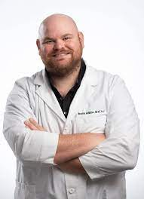
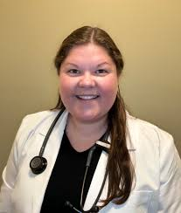
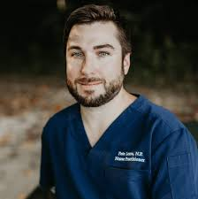
Preceptor Schedules
Pete – Cambridge: Tues (7–4), Salisbury: Wed–Thurs (7–4) and Fri (7–2).
[Use this link to schedule rotation time with Pete.]
PA McMullen – Salisbury: Mon–Tues (7–4), Cambridge: Wed–Thurs (7–4).
Molly Dale, DNP — Salisbury Mon & Weds (7-4). Cambridge Thurs (7-4).

Slide 5
Epic EMR Access
Before starting, please watch the Epic EMR training videos. You’ll get student access at the beginning of your rotation and are expected to use Epic for documenting patient encounters.
Please email us with the following information to create your Epic student account:
Full legal name
DOB
Email
Phone number

Slide 6
Epic EMR Access
Important notes:
Epic is only available on-site on our wifi (SWM).
A shared student laptop will be provided for you to use during your rotation.
You’ll need a Microsoft account to log in. Create one at microsoft.com.
Download Citrix Workspace here: Citrix Workspace App
Bookmark: TidalHealth Storefront
You will need to log in to the SRA storefront first to reset your password, and then use the above storefront from there. We will help you.
Please create a free account for this AI scribe. We will utilize this heavily during your rotation: https://www.heidihealth.com/
Epic EMR Training: Epic YouTube Channel

Slide 7
Expectations
You are a key part of the team while you’re here. Your performance will be evaluated by your preceptor and the clinical staff, based on both your clinical skills and your teamwork.
You’ll be involved in:
Interpreting labs and imaging
Performing patient assessments
Checking vitals
Assisting with EKGs, cultures, and other tests
Supporting daily clinic operations
Professionalism, initiative, and collaboration are expected—and they’ll reflect directly in your evaluation.
We’re glad you’re here and look forward to working with you. Use this time to learn, ask questions, and take full advantage of the opportunities you’ll get during your rotation.

Slide 8

Epic EHR Beginner Tutorial

Slide 9
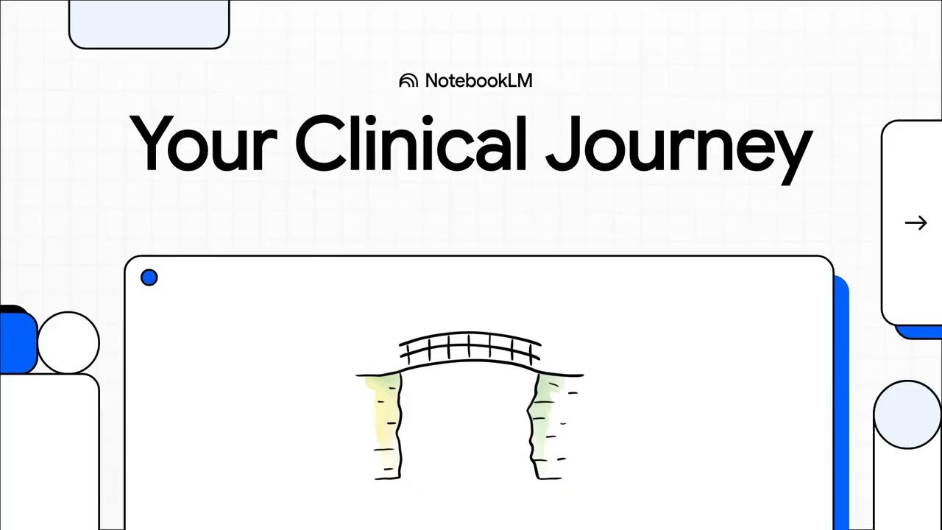
Introduction to Sailwinds and our preceptors
Pete’s Student Clinician Field Guide

Slide 10
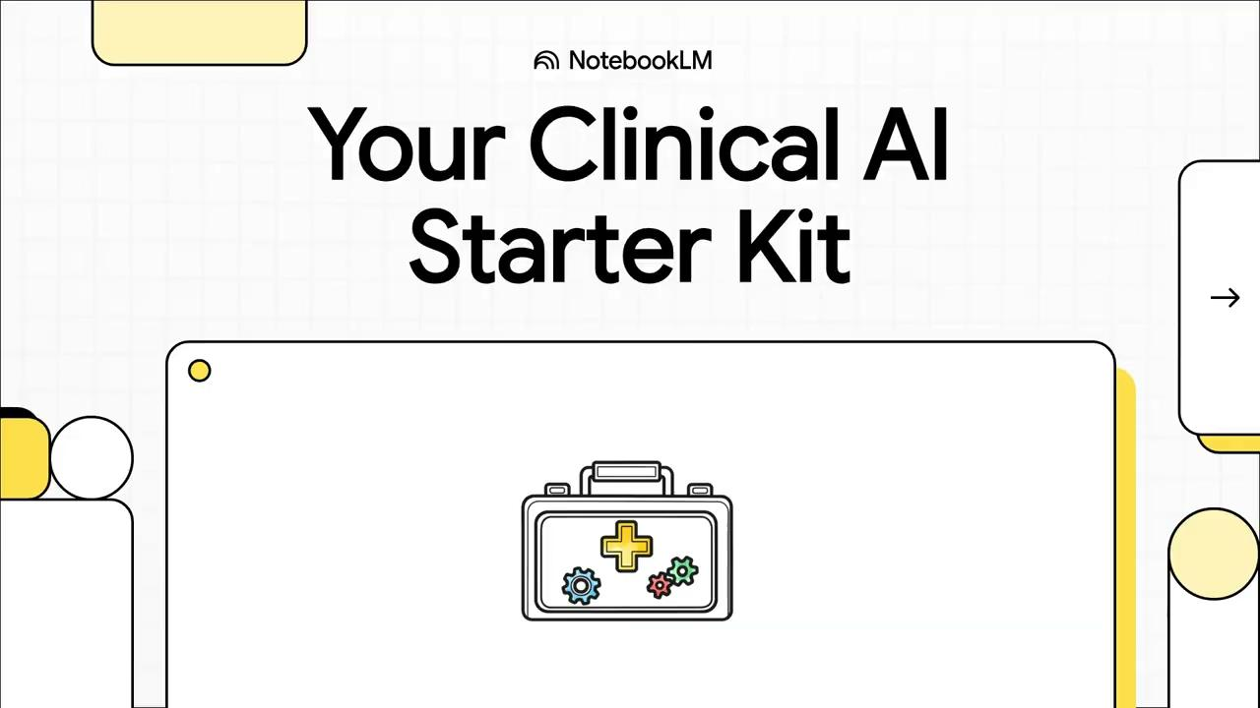
AI in Healthcare

Slide 11

HPI or CPI?

Slide 12

Generating a DDx, A & P

Slide 13

Communicating your assessment to your preceptor

Slide 14

Communicating your assessment to your patient

Slide 15

Writing your note

